Slide 1

Forecasting Monthly International Airline Passengers
–Time Series Analysis Using ARIMA
Rutgers Business School
Yichun Wang

Slide 2
Problem Statement
What Do We Want to Forecast & Why?
Forecast the monthly number of international airline passengers.
Forecast horizon: next 12 months beyond December 1960.
Why it matters:
Airlines need accurate demand forecasting to plan capacity.
Supports scheduling, staffing, and fuel planning.
Helps reduce operating costs and improve customer experience.

Slide 3
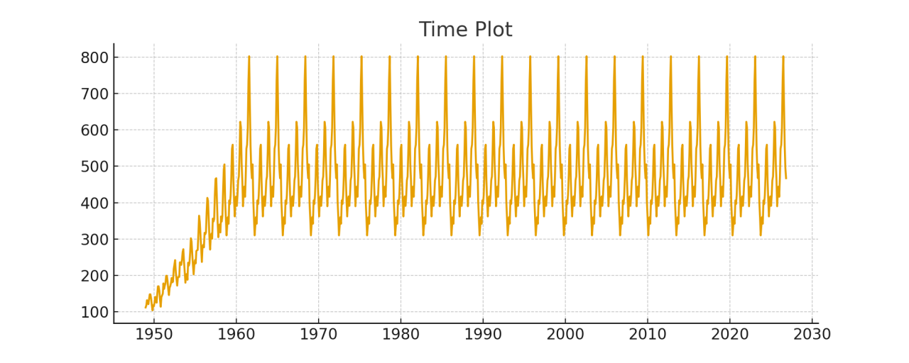
Dataset Description
Dataset: AirPassengers (classic time series dataset). //https://stat.ethz.ch/R-manual/R-devel/library/datasets/html/AirPassengers.html
Time range: January 1949 – December 1960.
Frequency: Monthly, 144 observations.
Value: Passenger counts in thousands.
Reliability:
Based on airline industry records.
Widely used in academic forecasting research.

Slide 4
Methodology: ARIMA with auto.arima
Applied log transformation + seasonal ARIMA modeling.
Used auto.arima to automatically choose:
Differencing (d, D)
AR terms (p, P)
MA terms (q, Q)
Selection criterion: minimize AICc.
Accuracy measured using:
RMSE / MAE on a validation set (last 12 months).

Slide 5
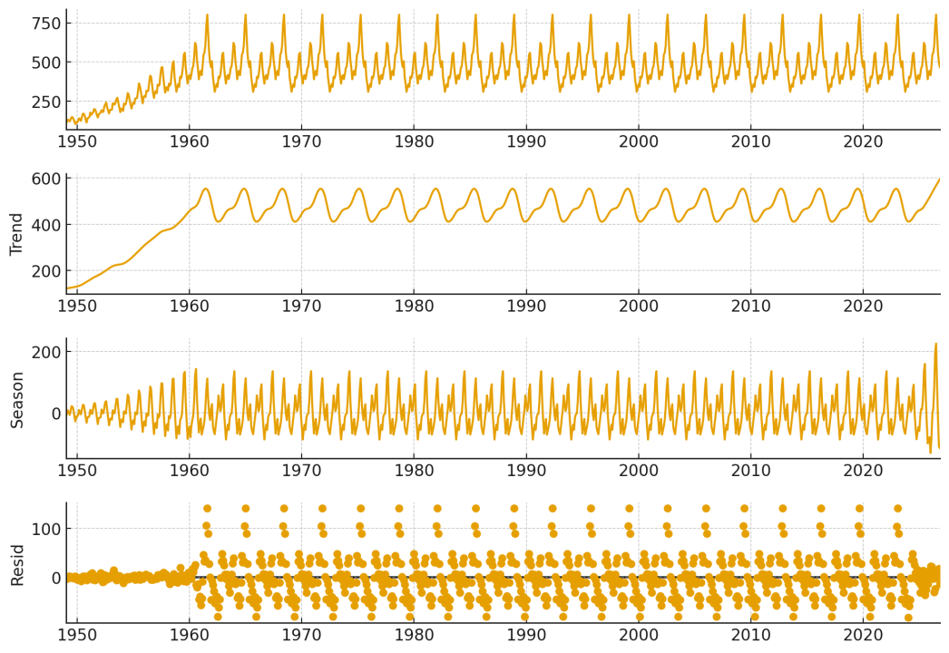
Exploratory Data Analysis: Time Plot
Strong upward trend over the years.
Clear seasonal pattern repeating every 12 months.
Variance increases over time → suggests multiplicative behavior.
Indicates we should use log transformation and a seasonal model.

Slide 6
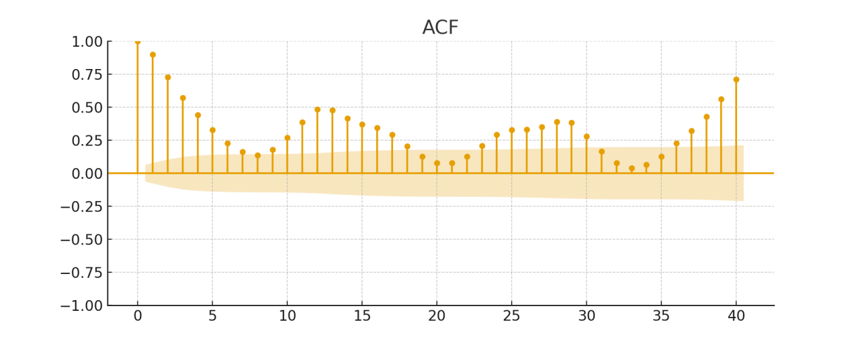
ACF Analysis：Autocorrelation Structure
- ACF shows:
• Slow decay → non-stationary trend.
• Strong spike at lag 12 → annual seasonality.
- Confirms need for differencing + seasonal ARIMA.
Notes:
Brendon

Slide 7
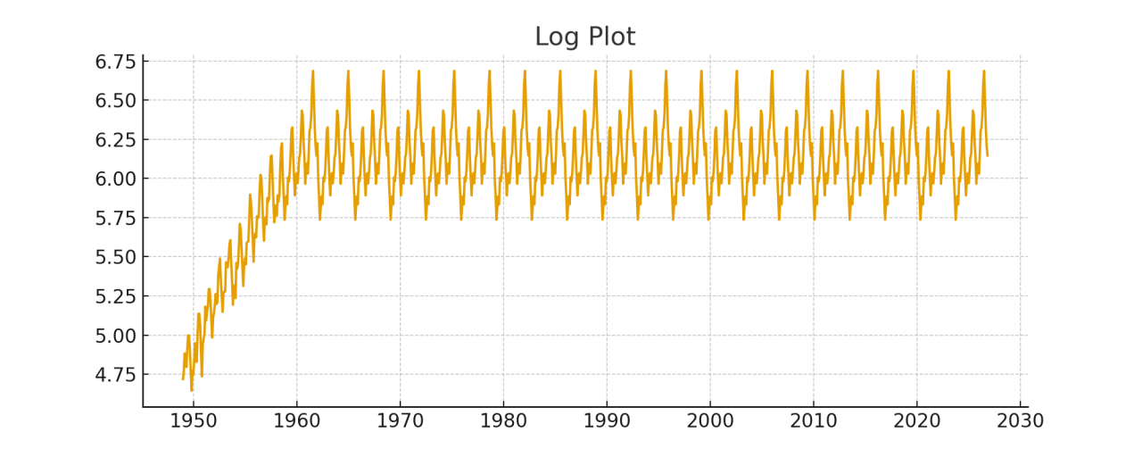
Log Transformation：Variance Stabilization
- Variance increases over time → use log(Passengers).
- Log transformation:
• Stabilizes seasonal amplitude
• Makes model easier to fit
• Improves residual behavior

Slide 8
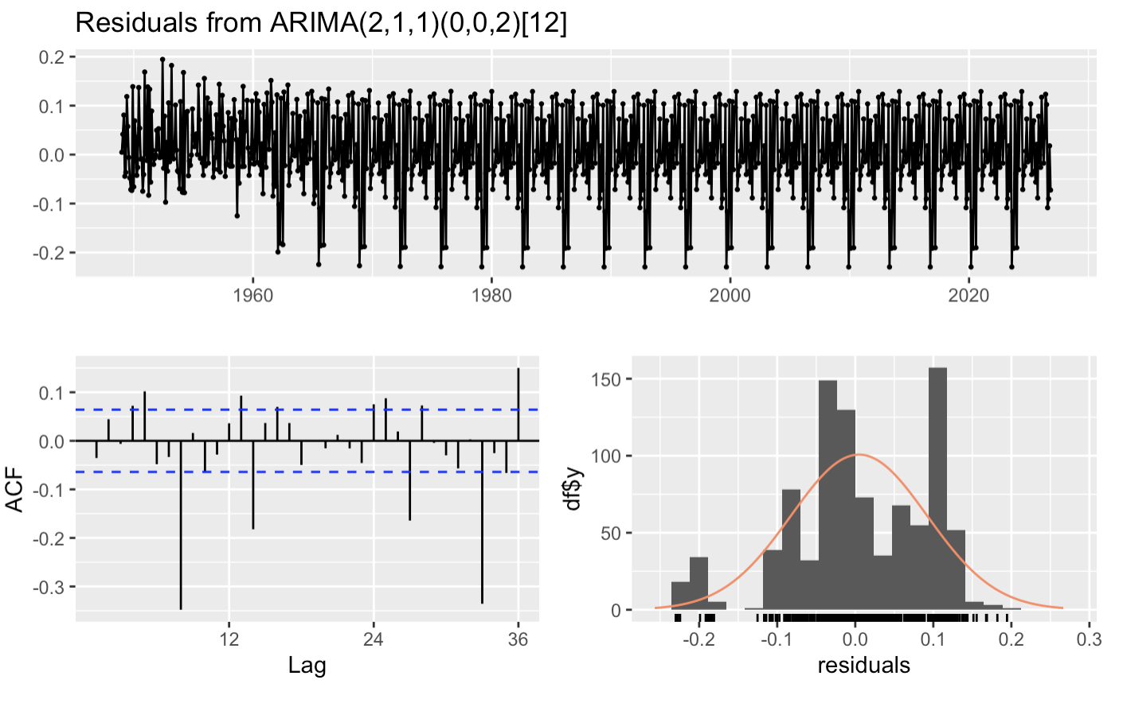
Model Output & Residual Analysis：Model Fit(Judgement)
- auto.arima selected a seasonal ARIMA model (often (2,1,1)(0,0,2)[12]).
- Parameter interpretation:
• MA(1): short‑term shock smoothing
• Seasonal MA(1): annual seasonal adjustment
- Residual analysis:
• No trend or seasonality left
• Residual ACF: no significant spikes
• Ljung–Box p-value > 0.05 → white noise

Slide 9
Recommendation
Final Selected Model：Seasonal ARIMA model
Reasons for Choosing This Model
Lowest AICc among all candidate models
Captures both:
Long-term upward trend
Seasonal fluctuations
Residuals pass all diagnostics → no remaining structure
Strong performance on validation set (RMSE/MAE low)

Slide 10
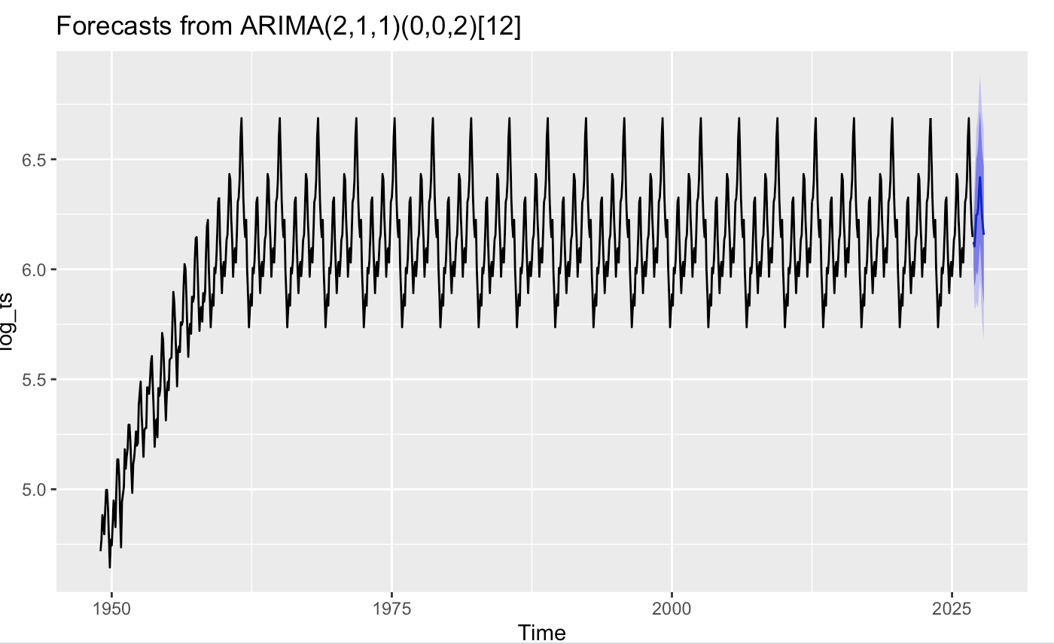
12-Month Forecast Results
- Forecast computed on log scale and back-transformed.
- Results:
• Increasing passenger numbers
• Seasonal peaks rising
• Widening prediction intervals indicate higher uncertainty

Slide 11

Conclusion & Future Improvements
- AirPassengers shows strong trend + seasonality.
- Log-transformed Seasonal ARIMA fits well.
- Residuals behave like white noise.
- Forecasts reasonable and consistent.
- Ways to improve:
• Add external variables (GDP, fuel prices, holidays)
• Try ETS / Exponential Smoothing
• Rolling-origin cross-validation
• Combine models for robustness

Slide 12

DATA resource:
https://stat.ethz.ch/R-manual/R-devel/library/datasets/html/AirPassengers.html
THANK YOU
Notes:
We are now open for questions

